Slide 1
URETHRAL INJURY

Slide 2
OUTLINE
Urethral trauma : Introduction
The male urethra :
- Anatomy
-Posterior urethral injury, c/f & management
-Anterior urethral injury, c/f & management
The female urethra
-Anatomy
-Injury, C/f & management

Slide 3
Urethral Trauma :Introduction
Relatively uncommon
10-20% of all injured patients
Mostly males, but can happen in females
Usually associated with pelvic fractures or straddle-type falls
Various parts of the urethra may be lacerated, transected, or contused
Vast majority are due to blunt trauma
Notes:
Female: severe pelvic fracture and bony displacement along with lacerations through the bladder neck and vagina are present in cases of urethral trauma.
Morbidity: 15% Men from 19-51! In previous studies, depending on the method used to repair the urethra, the rate of Incontinence/impotence is up to 70%, needing RE-operation to correct the problem.
Journal of Urology, 1996 : Stricture:49-97%. Impotence:0-36%. Incontinence: 0-21%. (Impotence and incontinence is a complication of procedures with less strictures.
Foley catheter is C.-I. if you suspect urethral trauma.

Slide 4
Gross hematuria and pelvic fracture = urethral injury until proven otherwise
The big 4 clues to urethral injury:
  Blood at meatus
  Gross hematuria
  Inability to void
  swelling of penis/labia majora

Slide 5
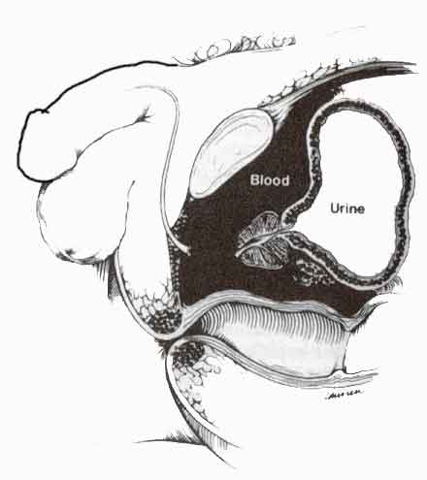
Urethral rupture
From McAnich JW. In Tanagho EA, McAninch JW, editors: Smith’s general urology, ed 14, Norwalk, Conn, 1995, Appleton & Lange.

Slide 6
THE MALE URETHRA
A membranous canal for ext discharge of urine & seminal fluid
About 8 inches (20cm) long
Extends from the neck of bladder to the external urinary meatus on the tip of the glans penis
Divided into three parts:-
  Prostatic
  Membranous
  Penile

Slide 7
Prostatic urethra
Length=3 cm
Extends from neck of bladder inside prostate gland
Structures openings into prostatic urethra:
  Ejaculatory ducts
  Ducts of prostate gland

Slide 8
Membranous urethra
Length=1 cm
Surrounded by external urethral sphincter
Penile (spongy) urethra
Length=16 cm
Extends inside penis & opens externally through external urethral orifice

Slide 9
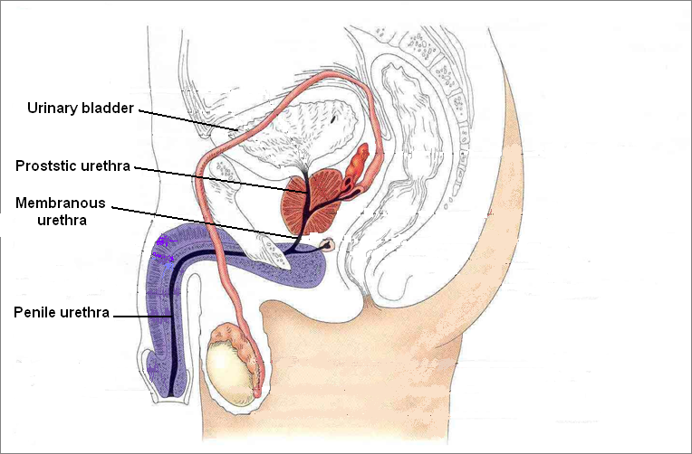

Slide 10
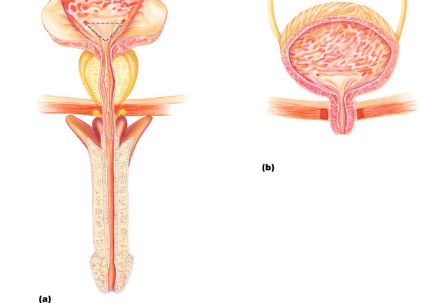
_______trigone
1. Prostatic urethra_______
2. Membranous urethra____
female
3. Spongy or penile urethra_____

Slide 11
According to location :- the male urethra
→1.Anterior urethra:
- bulbous & pendulous
→2.Posterior urethra:
- membrano – prostatic
Divided into :-
→1. Anterior &
→2. Posterior urethral injuries

Slide 12
Posterior Urethral Trauma: Etiology
Mechanism: Violent external force
Bilateral pubic rami fractures (straddle fracture) and sacroiliac fracture
Pelvic # : 25% of Posterior urethral injury
Associated bladder rupture in 10-17%
Rectal injury can lead to urethral-rectal fistula in 8%
73% is complete, 27% partial

Slide 13
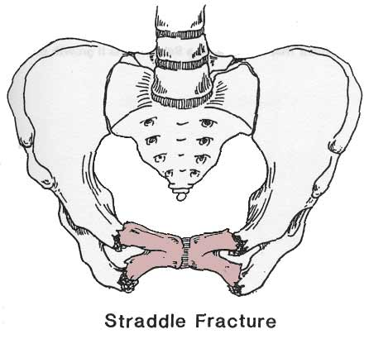
Kozin, Berlet. Handbook of Common Orthopaedic Fractures, 4th ed., 2000.

Slide 14
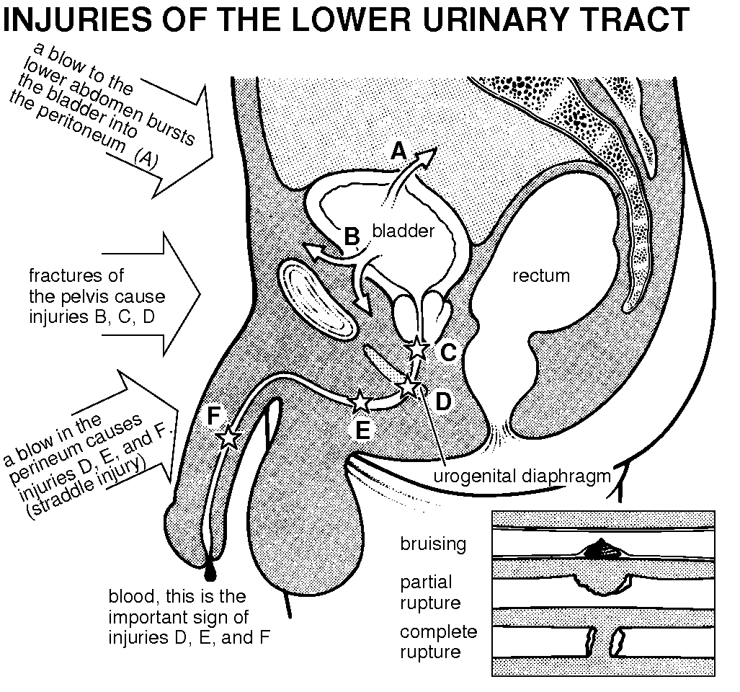

Slide 15
Symptoms: -
C/O -lower abd pain
H/O -crushing injury to the pelvis is usually obtained
Gross hematuria in 98%
Inability to void

Slide 16
Signs: -
Blood at the urethral meatus (Urethroragia)
Suprapubic tenderness and the presence of pelvic fracture
A large developing pelvic hematoma may be palpated
Perineal or suprapubic contusions are often noted
large pelvic hematoma with the prostate displaced superiorly on DRE
Notes:
Blood at the urethral meatus is the single most important sign of urethral injury (Urethroragia).
Rectal examination may reveal a large pelvic hematoma with the prostate displaced superiorly.

Slide 17
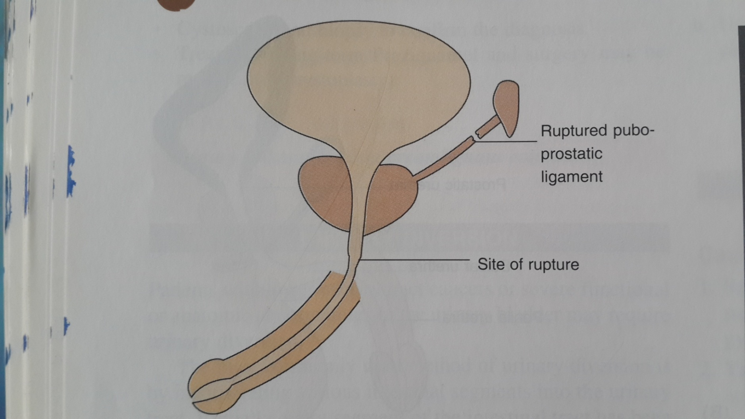

Slide 18
Laboratory Findings:-
Anemia due to hemorrhage may be noted
Urine usually cannot be obtained initially, since pt should not void and catheterization should not be attempted.

Slide 19
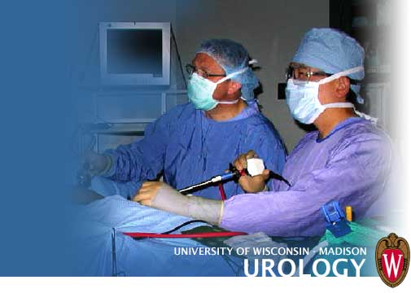
Instrumental Examination:
The only instrumentation involved should be for urethrography.
Catheterization should not be done due to increased risk of hematoma, infection, and further damage to partial urethral disruptions.

Slide 20
Retrograde Urethrogram:-
Pretest KUB film
Supine position
Injection of 25ml of water-soluble contrast
X-ray after 15ml and 25ml
Post-voiding x-rayWill either be:
    Normal
    ‘Partial’ urethral injury (some dye in bladder, some extravascation)
    ‘Complete’ urethral injury (no dye in bladder)
Notes:
KUB to identify pelvic fracture, bony displacement, foreign objects.
Christmas tree adapter on the end of a 60cc syringe.

Slide 21
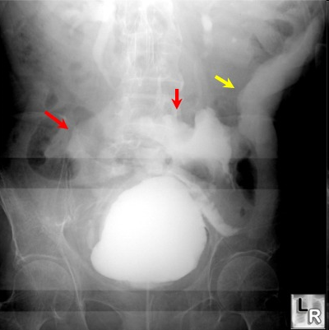
Pelvic fracture

Slide 22
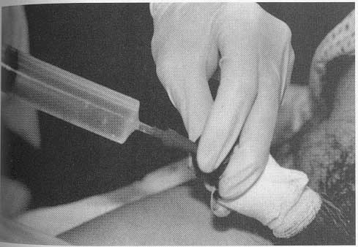
Retrograde Urethrogram

Slide 23
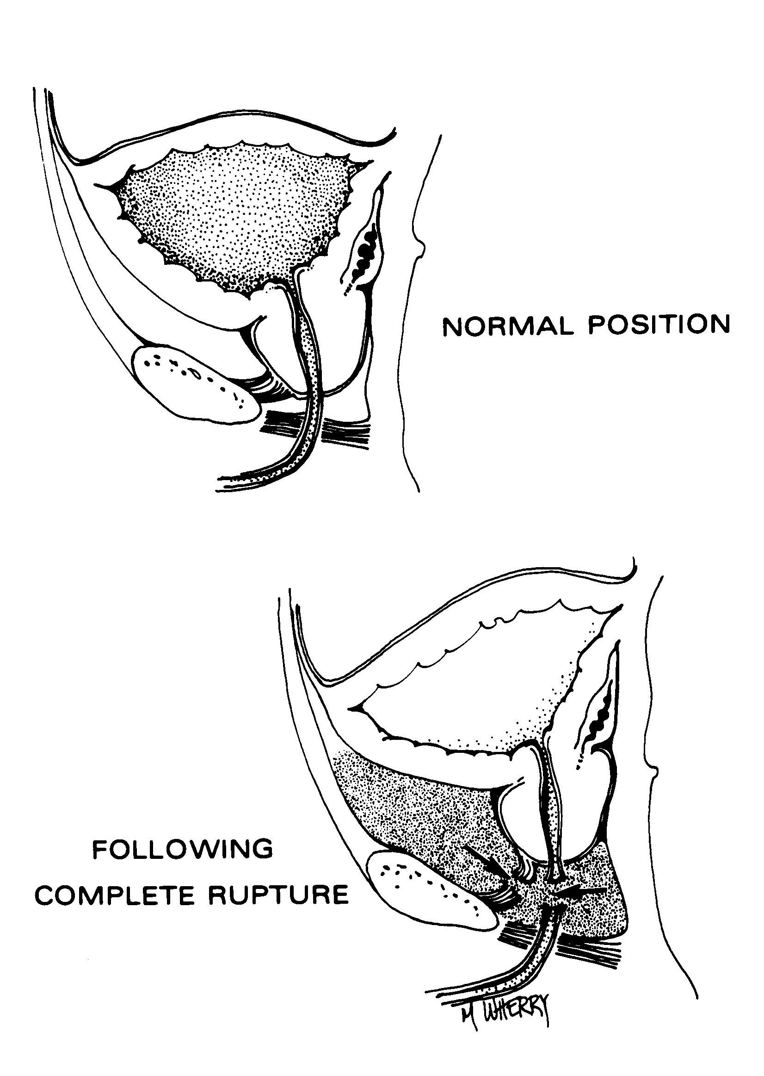


Slide 24
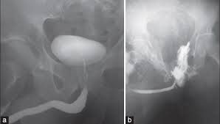
Retrograde Urethrogram
Normal
Urethral Injury

Slide 25
Urethrogram
Contrast extravasation + Contrast in bladder
Contrast extravasation only
PARTIAL Tear
COMPLETE Tear

Slide 26
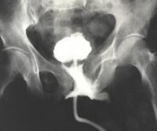
Partial Tear

Slide 27
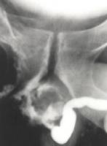
Complete Tear

Slide 28
Posterior Urethral Trauma: Diagnosis
→Blood at meatus: 50%
→“High riding prostate”: 34%
→Inability to urinate
→Inability to place urethral catheter
→Rarely, perineal hematoma (late finding)
→Triad:
Blood at the meatus
Inability to urinate
Full bladder

Slide 29
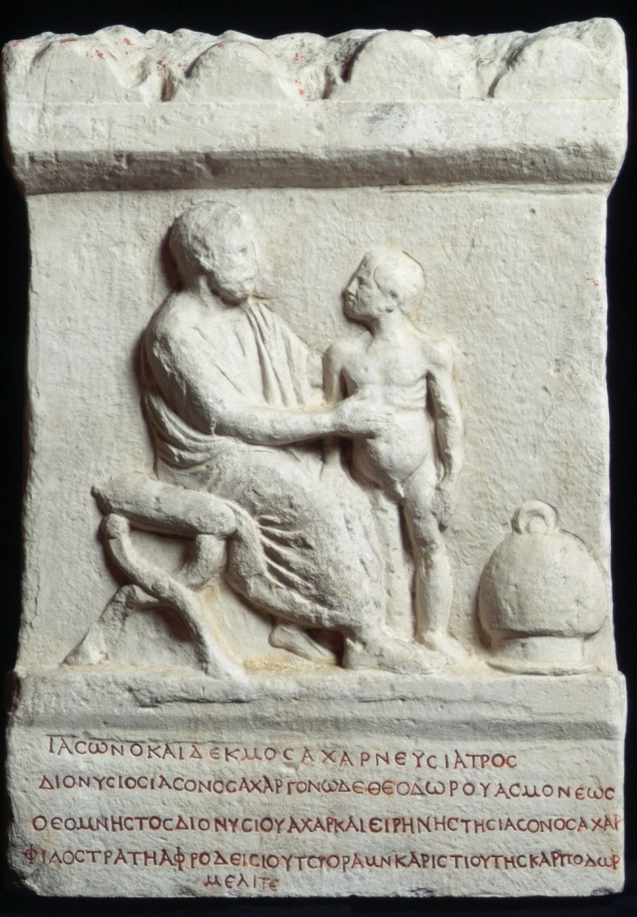
MANAGEMENT
Shock and hemorrhage should be treated.
Conservative therapy →for patients with nonpenetrating damage of urethra:- rest, cool compresses, and antibiotics.

Slide 30
If no concern for injury/ retrograde urethrogram normal, put a foley in
1.Partial tear
  careful passage of 12-14 Fr. Foley
  →If any resistance: Urology
2.Complete tear:
  Urology + suprapubic cath

Slide 31
Surgical Measures:
Initial management→suprapubic cystostomy to provide urinary drainage
A midline lower abdominal incision should be made
Bladder should be opened and carefully inspected for lacerations

Slide 32
If laceration → bladder should be closed with absorbable suture material & a cystostomy tube inserted for urinary drainage
The suprapubic cystostomy is maintained in place for about 3 months
This allows resolution of the pelvic hematoma
Prostate and bladder will slowly return to their anatomic positions

Slide 33
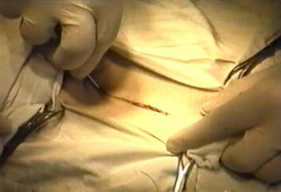
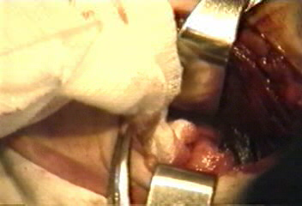
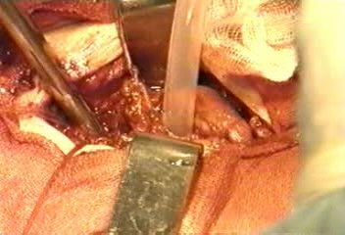
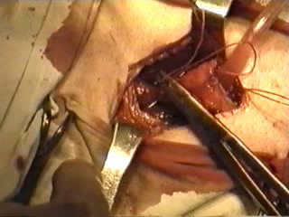
Film Suprapubic Cystostomy

Slide 34
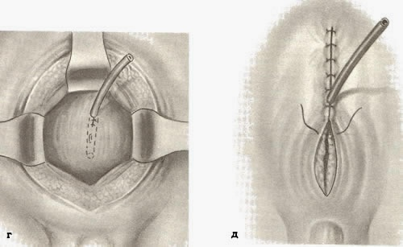

Slide 35
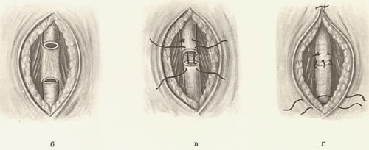
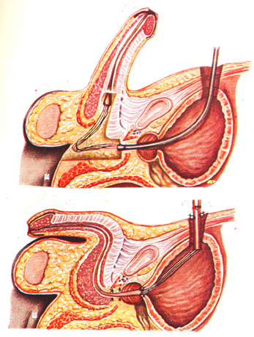
Urethral reconstruction
After prostatic disruption can be undertaken within 3 months
Before reconstruction, an urethrogram should be done
→ to determine the exact length of the resulting urethral stricture

Slide 36
A single-stage reconstruction of the urethral rupture defect with direct excision of the strictured area→ anastomosis of the bulbous urethra directly to the apex of the prostate.
A 16F silicone urethral catheter should be left in place along with a suprapubic cystostomy.
Catheters are removed within a month, and the patient is then able to void

Slide 37
What 4 things are necessary before you can attempt to pass a foley catheter?
→4 things allowing you to pass a foley safely:
1. No pelvic and suprapubic tenderness / #
2. No penile, scrotal, or perineal hematoma
3. No blood at the urethral meatus
4. No abnormal findings on DRE

Slide 38
Anterior Urethral Injury
More common than posterior
Direct trauma
Usually NO pelvic #
Straddle injury :- laceration or contusion
Instrumentation :- may cause disruption of urethra
Notes:
- bulbous injury is the most common urethral injury
- direct trauma so history is very suggestive (fall astride a bicycle, post, etc.)

Slide 39
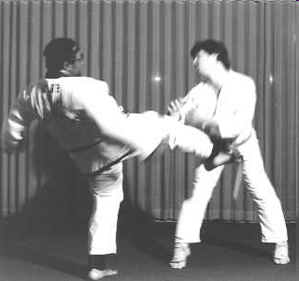

Slide 40
Symptoms:-
H/o of direct perineal trauma
H/o instrumentation
Local pain in perineum
Inability to void

Slide 41
Signs:-
Blood at meatus (the most important predictor)
Perineal and scrotal swelling
Very tender perineum
Sometime a mass may be found
Rectal exam→ normally placed prostate

Slide 42
If Buck’s fascia intact blood & urine remain within the penis ‘sleeve hematoma’
If Buck’s fascia disrupted → blood & urine can spread to the scrotum & perineum
Extravasation into the perineum ‘butterfly sign”

Slide 43
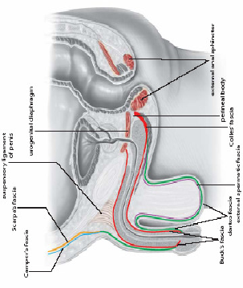

Slide 44
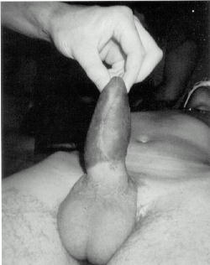
Sleeve Hematoma
Notes:
Penile injury confined by Buck’s fascia. Corporal rupture during intercourse. Scrotum normal.
SLEEVE hematoma.

Slide 45
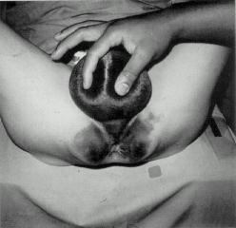
Butterfly Hematoma
Notes:
Anterior urethral rupture through Buck’s fascia confined by Colles’ fascia.

Slide 46
X-ray finding
Contused urethra → no evidence of extravastion
Urethrogram→ shows extravastion & location of injury

Slide 47
Management :-
1.URETHRAL CONTUSION
→ Urethrography :- urethra remain intact & no extravasations →allow voiding :-
1.Voiding without pain /bleeding → no additional T/t
2.Bleeding persist→urethral catheterisation

Slide 48
2.URETHRAL LACERATION
→ Severe straddle injury resulting in laceration of part of urethral wall
→Suprapubic cystostomy
→wait for 2-3 week
→Healing at injury site →allow voiding

Slide 49
3. U.L. WITH URINARY EXTRAVASATION
→Urinary extravasation may involve perineum,scrotum & lower abd
→drainage of these area
→Inf.→Abcess formation→drainage of abcess

Slide 50
4.IMMEDIATE REPAIR
→ Primary repair for stab wounds
→ Surgical manage is conservative debridement & primary end-to-end anastomosis

Slide 51
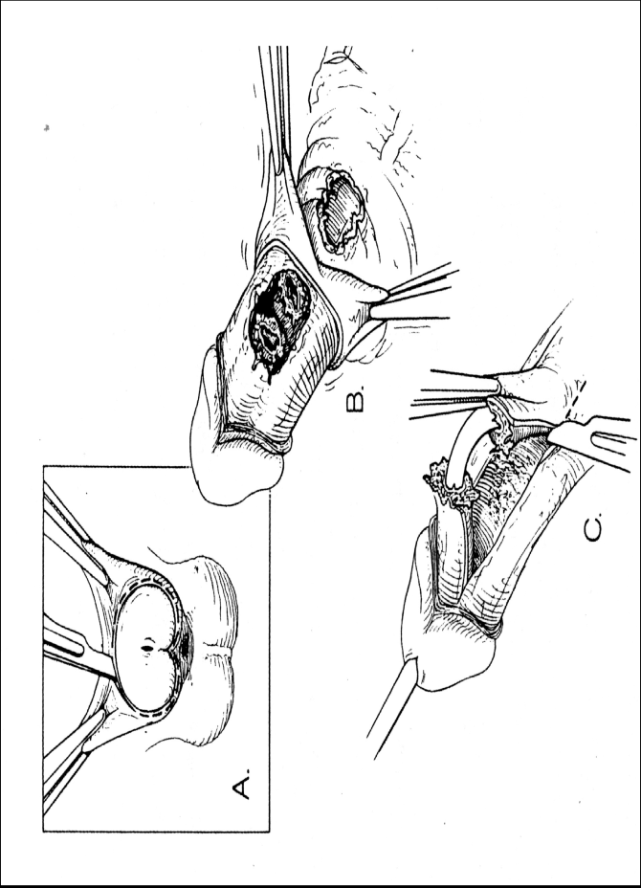

Slide 52
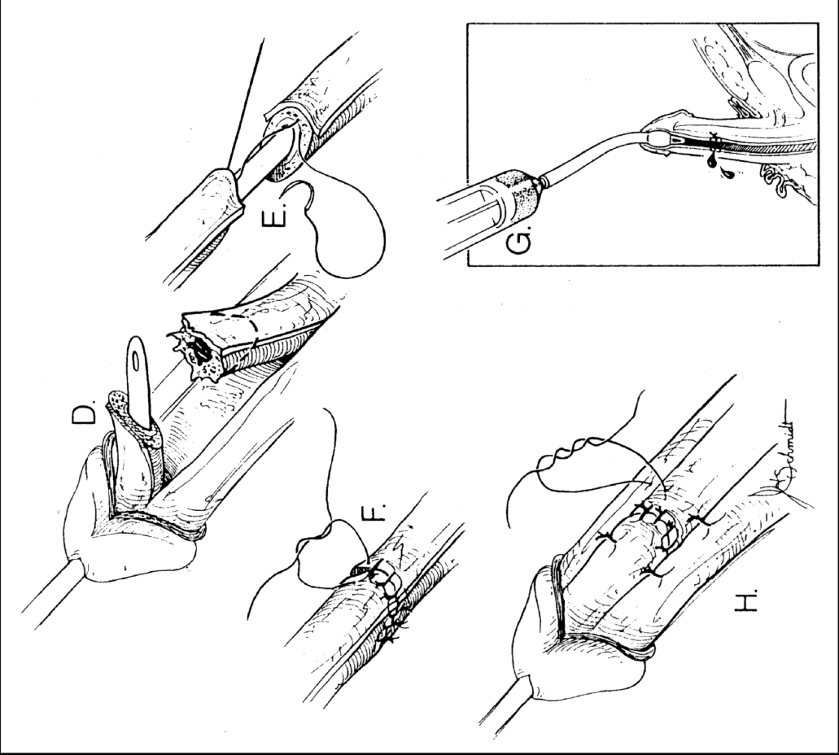

Slide 53
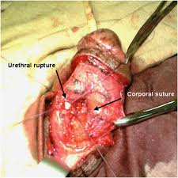

Slide 54
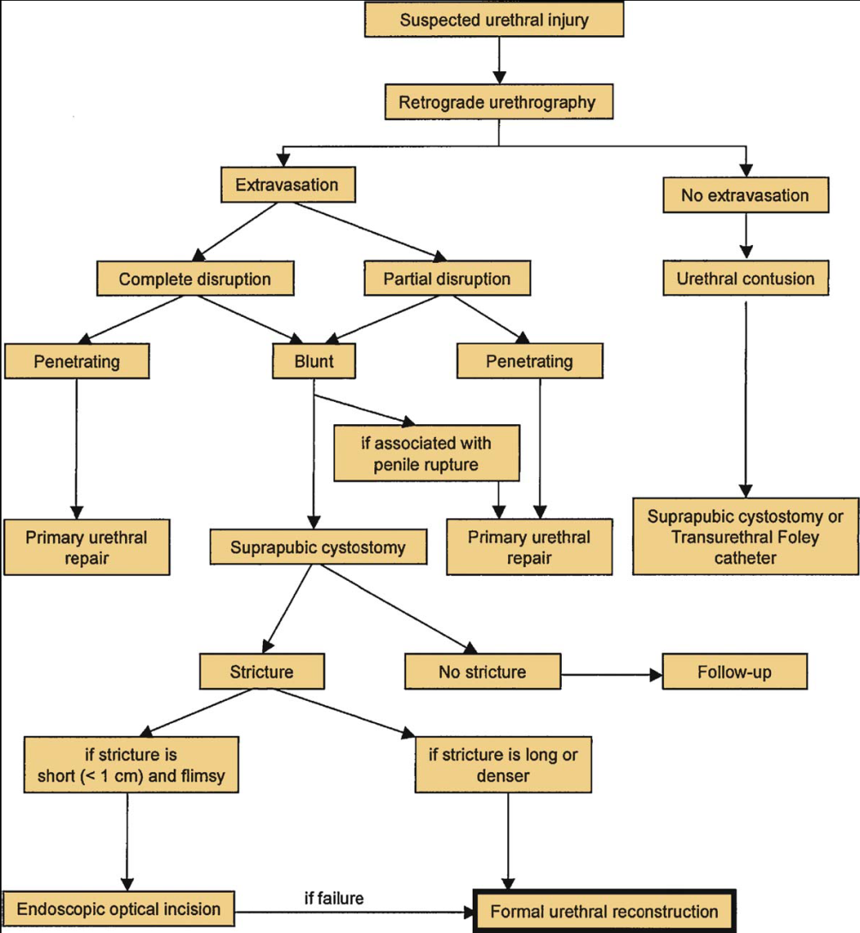

Slide 55
THE FEMALE URETHRA
4 cm long & 6mm in diamter
Extends from neck of urinary bladder to open externally through the external urethral orifice (anterior to the vaginal opening)
Has only urinary function
Easily dilatable & catheters or cystoscopes can be easily passed through it

Slide 56
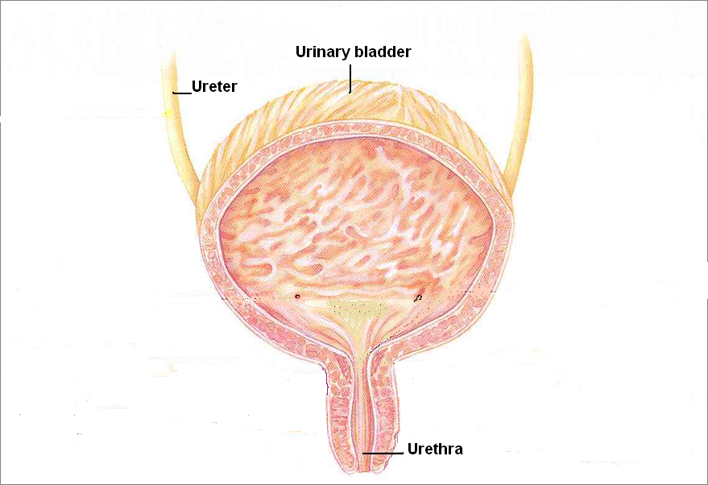
Female Urethra

Slide 57
Female Urethral Injuries
→Only 5% in females( males 25% ) of all pelvic fractures have urethral injury
→Frequently associated with vaginal lacerations and rectal tears
→C/O-Labial swelling & haematuria

Slide 58
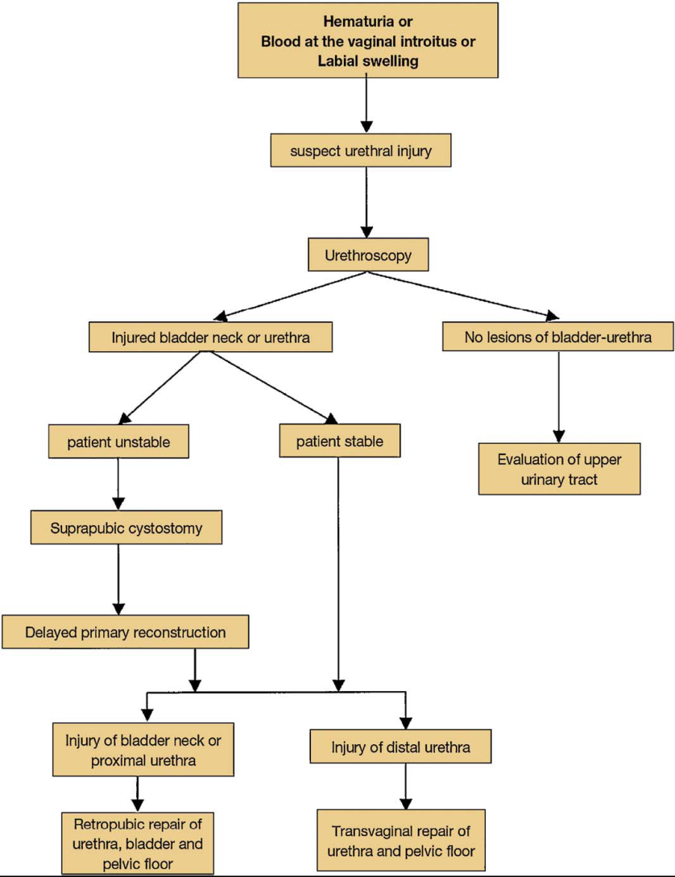

Slide 59

FLY HIGH
Thanx & Good Luck

